Slide 1
GENERATION EQUALITY FORUM
what we need to know
18 June 2020

Slide 2
What is the Generation Equality Forum (GEF)?
Objectives of GEF stronger than ever – system change through partnerships, solidarity and movement building
GEF is a global gathering for gender equality, convened by UN Women and co-chaired by France and Mexico
GEF is envisaged as a global public conversation for urgent action and accountability for gender equality.
It will celebrate the power of activism, feminist solidarity and youth leadership to achieve transformative change.
GEF outcomes - a feminist agenda setting space and the setting up of Action Coalitions - an urgent, joint action agenda by a group of committed stakeholders.
The Forum aims to make gender equality not only unstoppable but culturally irresistible.
GEF website- https://forum.generationequality.org/
2

Slide 3
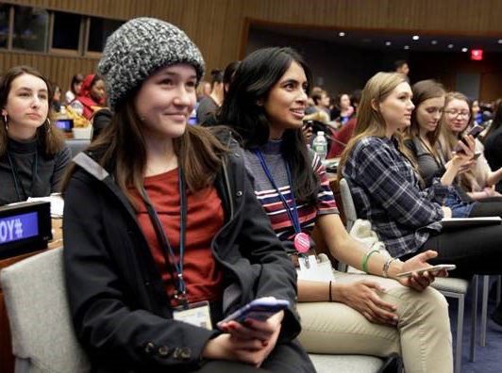
Outcome
2030 deadline
Expiration of gender inequality
Immediate actions for implementation:
Action Coalitions set up with funding in the period 2020-2025
Feminist Agenda Setting
Action Coalitions
Voices of women and youth drive the gender equality agenda forward

Slide 4
Guiding Principles for Engagement
Center-stage youth in decision-making and work processes
Maintain a multi-stakeholder and intersectional approach
Amplify voices from civil society
Strengthen public engagement
Notes:
Centre-stage youth:
Youth will be engaged in all stakeholder engagement activities: there will be a significant representation of youth participant in the public conversations to ensure they are consulted throughout the project and their voices are centralized in the objectives and outcomes; representatives of the Youth TF will be integrated in the various sub-groups to contribute technically to the advancement of the various workstreams of the GEF; they will have a seat in the core group to ensure that their voice is included in making decisions
Maintain a multi-stakeholder and intersectional approach:
The GEF is at its essence a multi-stakeholder endeavour to generate partnerships that will drive change, In this context, we aim to include in our discussions as many partners as possible- from private sector, to governments, to citizens and artists to commit to actions to generate change.
Amplify voices from civil society:
Across all stakeholder engagement activities, civil society will be actively engaged and in the lead: from participating to the WOW festival, to partnering with global citizens, to leveraging the voices or artists and influencers, to being center-staged in the curated discussion- we aim to deepen and broaden the reach of the GEF.
Public engagement:
Through the public conversations and the curated discussions, we wish to engage both seasoned activities and everyday citizens in the project, ‘bringing the GEF to the people’ through communication and outreach and ‘bringing people into the GF” through the public conversations. The latter will take place through an online platform that will provide the space for those outside of the GEF to contribute to discussion happening around the forum and contribute to driving some of the expected outcomes and objectives.

Slide 5
What are Action Coalitions ?
Action Coalitions are innovative partnerships among Civil Society, Member States and Business, as well as other stakeholders (parliamentarians, trade unions, mayors etc.) to achieve accelerated implementation of gender equality commitments.
The Action Coalitions will prioritize scaled up, concrete, transformative and measurable results for gender equality in the period 2020-2025
A set of immediate actions for implementation of commitments will be developed through Action Coalitions with timelines and funding
6+1 Action Coalitions:
1. Gender Based Violence
2. Economic Justice and Rights
3. Bodily autonomy and sexual and reproductive health and rights
4. Feminist action for climate justice
5. Technology and innovation for Gender Equality
6. Feminist movements and leadership 7. Women, Peace and Security
5

Slide 6
Each Action Coalition Leadership Team will choose a set of specific actions and accompanying tactics to drive systemic change in its theme
Gender-Based Violence
Theme
Cross-cutting lens
ACTION 1
ACTION 2
ACTION 3
Actions
Data & Accountability
Intersectional discrimination
Norms
Laws & Policy
Tactics
Financing
Education
Service Delivery
SYSTEMIC CHANGE

Slide 7
Timeline
April-May 2020
June-Aug 2020
Sept-Dec 2020
Jan-April 2021
(tbc*)
Mexico City Forum
Paris Forum
Reset GEF strategies in light of COVID-19
Build an engagement plan, stakeholder mapping and communications strategy
Engage & Collaborate
Launch public conversations - key online collaborative space esp. with CSOs
Key Engagements: Curated Discussions begin
Key events: Virtual HLPF on SD, 7-16 July, CSW64, Youth Day Celebrations (12 Aug)
Energize, Build & Prepare
Public Conversations continue to foster dialogue, connect, & amplify key issues
Key Engagements:
Curated Discussions; Potential event with Global Citizen (Sept)
Key events: UNGA, Sept, UNSCR 1325 Anniversary, Oct, 16 Days of Activism, Nov, Human Rights Day, Dec
Accelerate
Ramp up communications and advocacy
Registration platforms launched, travel support implemented, SSs finalized
Key events: AWID Forum & CSW65
Activate
GE advocates set the stage for GEF and renewed gender commitments
Satellite Sessions (TBC)
Culmination
Culmination of GEF with renewed gender commitments at highest levels
Satellite Sessions in parallel (TBC)
* Timeline may shift – depending on dates of Mexico Forum

